Slide 1






FY2021 Budget: Revenue Projections Presentation
Agenda
Budget Timeline
FY2020 Revenue: COVID-19
Enrollment Projections
State Budget Highlights
Revenue Projections
Appendix
Engage. Inspire. Prepare.
March 24, 2020
Version 1.1

Slide 2
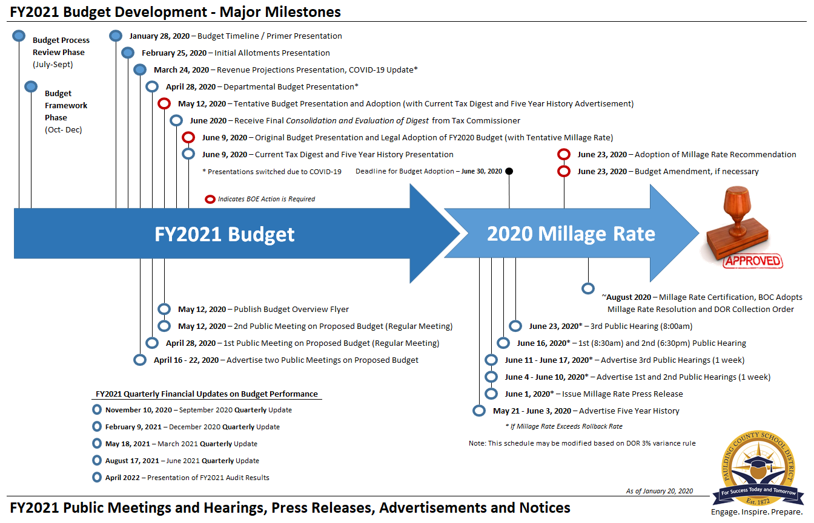
FY2021 Budget Approval Timeline
March 24, 2020
Revenue Projections
Presentation
1 | Budget Timeline

Slide 3
FY2020 Revenue: COVID-19
State and Federal Funding
“There are currently no plans to alter state or federal funding. From our perspective, we have the infrastructure set up to continue reimbursements of the DE 147 reports (grants) and the QBE allocations will continue to be paid monthly.”
Local Revenue:
Property Tax (411100) – 98% of the (2019 tax) budget collected
Intangible Tax (411210) – 85% of the budget collected
TAVT (411910) – 71% of the budget collected
All other local sources account for <1% of the budget
In total, we’ve collected 94% of the budget
SPLOST V
SPLOST is a consumption tax and will be negatively impacted. However, we are cumulatively $3.8m or 6.1% ahead of projections, with $10.5m over our minimum fund balance as of 2.28.20.
As of 3.17.20 unless otherwise noted
2 | FY2020 Revenue
Notes:
411100 - Property Tax
An economic slowdown could result in higher delinquencies and declining values.
411210 - Intangible Tax
This revenue source correlates with the housing market.
411910 – TAVT
This revenue source correlates with the auto registration.
SPLOST is 77% complete
411100 - Property Tax
Includes Ad Valorem tax on Real & Person Property, Motor Vehicles, Mobile Homes, Timber, Heavy-duty Equipment, delinquencies, interest, and Not-on-Digest items (NODs).
411210 - Intangible Tax
Every holder of a long-term note secured by real estate must record the security instrument in the county in which the real estate is located. A recording tax, or intangible tax, is charged based on the value of the property. Also, a transfer tax is imposed on the transfer of real estate.
SPLOST

Slide 4
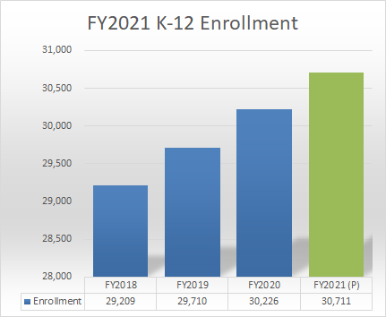
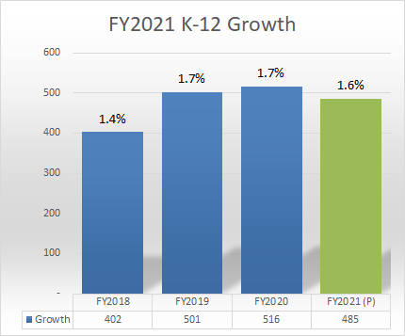
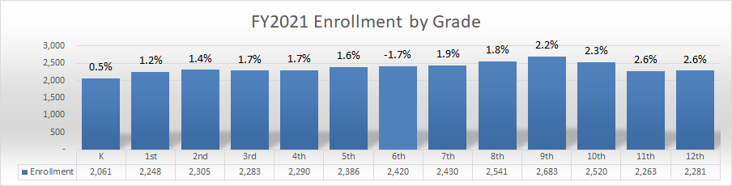
FY2021 Enrollment Projections
3 | Enrollment Projections
Notes:
Details are in the Appendix

Slide 5
FY2021 State Budget Highlights
State Budget
The House passed the FY21 budget and transmitted it to the Senate on 3.10.20. General Assembly suspend the session on 3.13.20.
Current Track Sheet Highlights:
$1,000 Increase to Certified State Salary Scale
5% Increase to Transportation Base Salary Scale
  QBE funds 90 of our 352 positions
  Approximately 8% of our total salaries and benefits
  90 x $10,277 state base (including social security and sick)
  Approximately $46,000 in additional funding
Fully fund school counselor ratio at 1:450 for all QBE student categories
  $460k increase in funding ($4.5m QBE vs $7.1m Budget)
5% Increase to SNP Salary Supplement
  $1.1m Statewide Increase
2% Increase to School Nurse Pay
  $677k Statewide Increase
As of 3.17.20 unless otherwise noted
4 | State Budget Highlights
Notes:
Increase funds to adjust the state base salary schedule to increase salaries for certified personnel by $1,000 effective September 1, 2020
Increase funds to provide a 5% increase to the state base salary for local school system transportation employees ($4.4m statewide)
Increase funds to provide a 5% increase to the salary supplement for local school system food service employees ($1.1m statewide)
65.50 Budget vs 68 QBE
Increase funds to provide a 2% pay raise for school nurses ($677k statewide)
Fully fund school counselor ratio at 1:450 for all QBE student categories pursuant to HB 283 ($24.8m statewide)

Slide 6
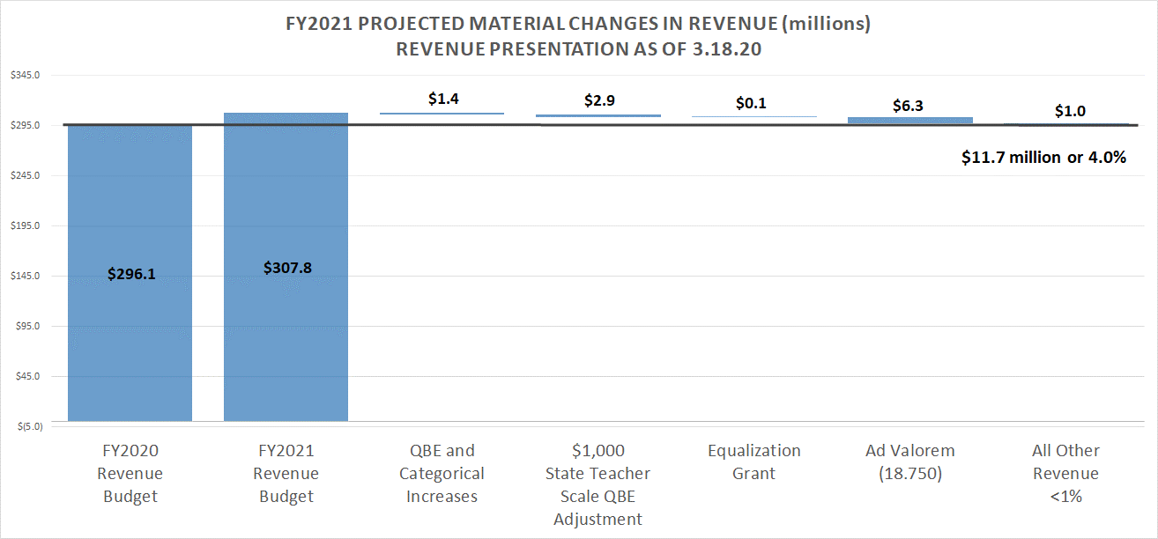
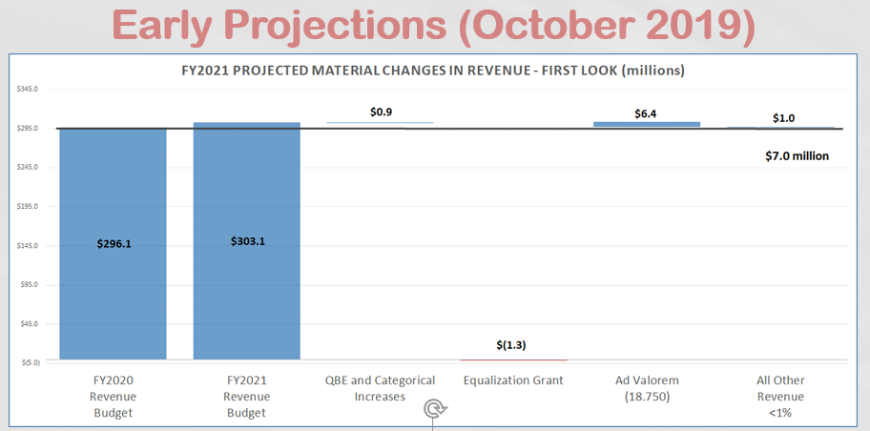
FY2021 Projected Changes in Revenue
5 | Revenue Projections
Notes:
Initiatives Next…

Slide 7
FY2021 Budget Approval Timeline
April 28, 2020
Departmental Budget Presentation
1 | Budget Timeline

Slide 8
Thank You
For Budget Ideas and Feedback
Visit our Website (Budget Feedback)
Engage. Inspire. Prepare.

Slide 9
Appendix
Engage. Inspire. Prepare.

